Slide 1

Team Alpha
Arturo Benitez
Brian Starr
Anna B

Slide 2

Problem Statement
What type of action movies are the most profitable ?
What Production Method is the most profitable.
Animation/ Live Action
Live Action
Does the Lead Type and the Cast Diversity have a notable correlation to profitability?

Slide 3
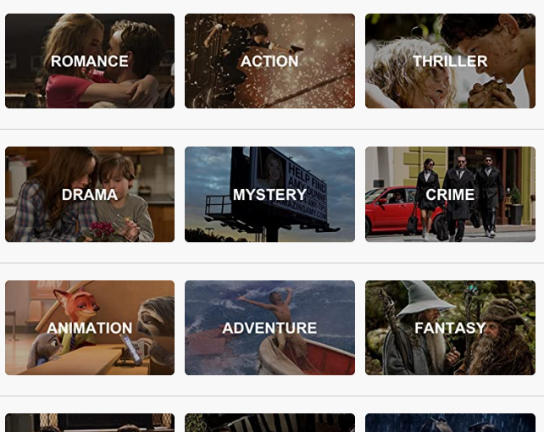
ARE ACTION MOVIES A GOOD INVESTMENT?
IF ACTION MOVIES ARE A GOOD INVESTMENT WHAT TYPE IS THE MOST PROFITABLE?

Slide 4

DICTIONARY WORDS
ROI - Return on Investment
PROI – Percentage of Return on Investment

Slide 5
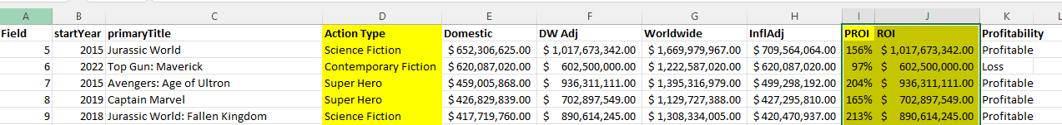
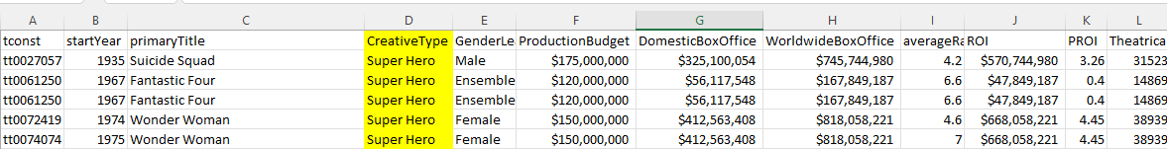
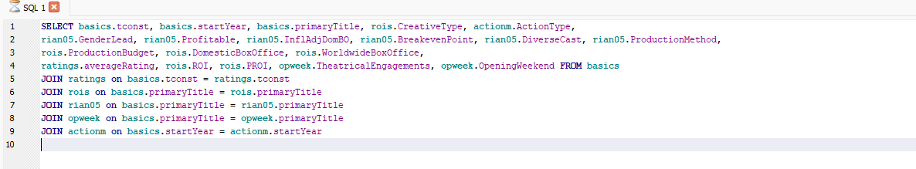
Data import and extraction FROM EXCEL TO SQL
Action movie type report & ROI formulas
Super Hero movie report
JOINED REPORTS IN SQL

Slide 6
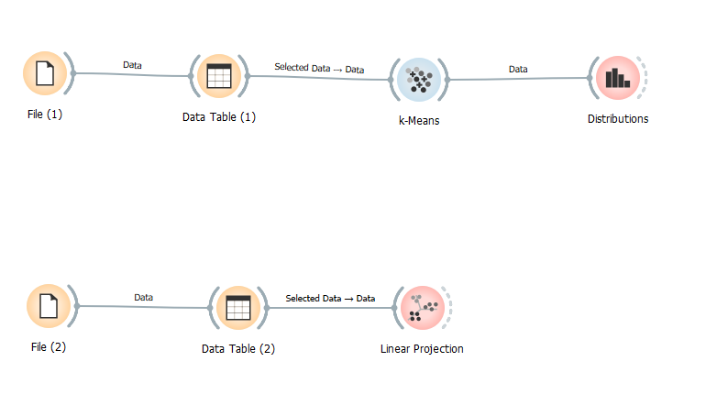
FROM EXCEL AND SQL IMPORTED REPORT IN PYTHON TOOL - ORANGE

Slide 7
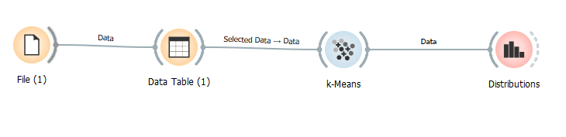
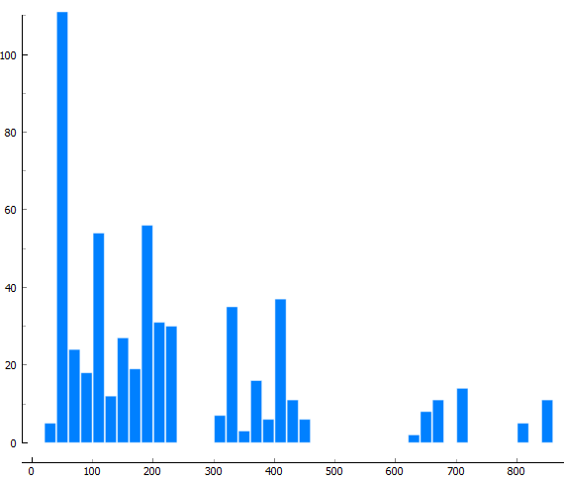
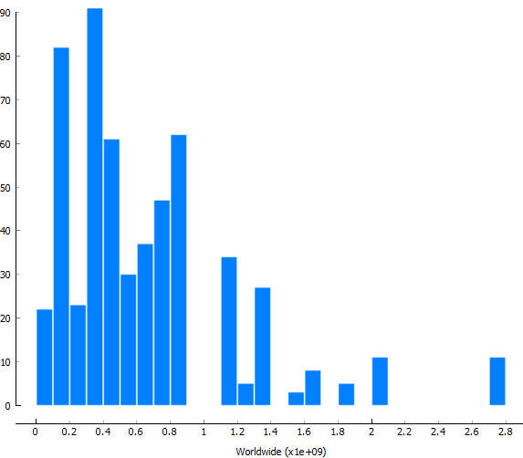
Action movies profits Domestic
Action movies profits Worldwide

Slide 8
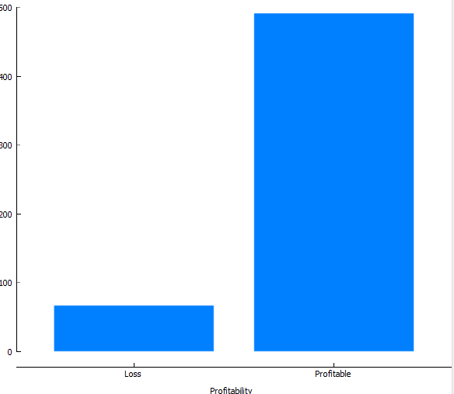
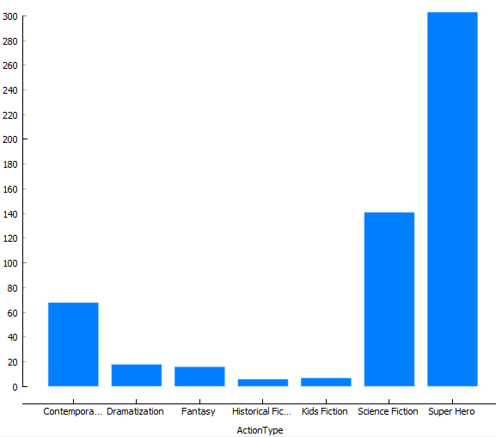
Action movies profits based on Earnings
Action movies profits by Action Movie Types

Slide 9
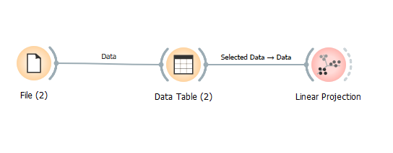
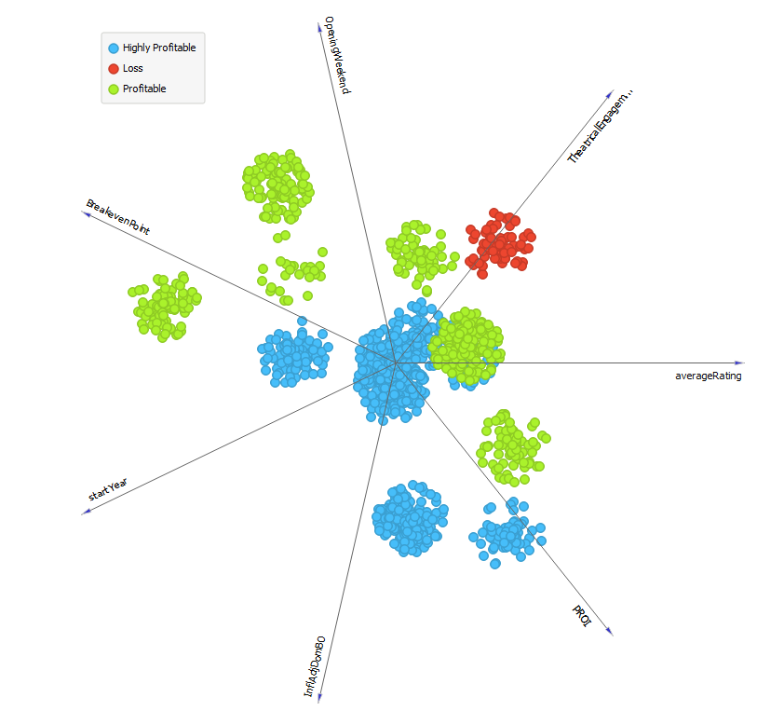
Actions movies profit influenced by following factors:
PROI
Inflation Adjustment
Average Ratings
Theatrical Eng.
Opening Week
Breakeven Point
Start Year

Slide 10
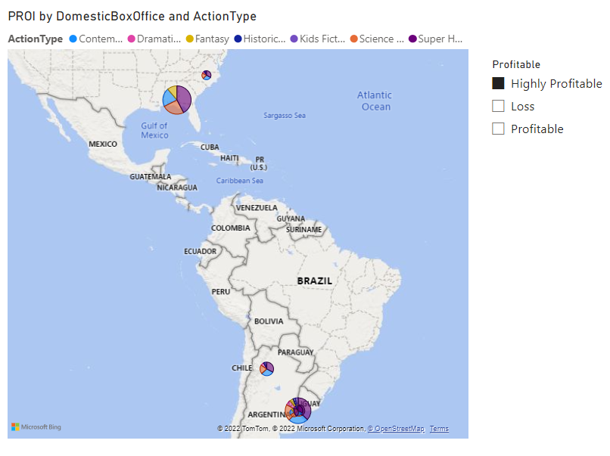
USED POWER BI TO ANALYS PROFITABILITY FURTER AND TO GET BETTER VISUAL PERCEPTION
..\Desktop\DATA BOOTCAMP\Capston data\MASTER.pbix
Map of most profitable Action movies

Slide 11
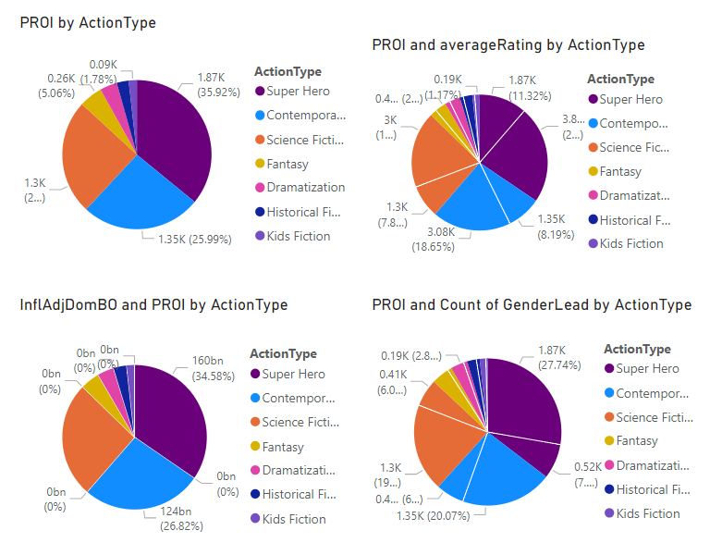
ANALYZED IMPACT OF FOLLOWING FACTORS ON PROFITABILITY OF ACTION MOVIES:
PROI by:
Action Type
Ratings
Inflation Adjustments
Profitability

Slide 12
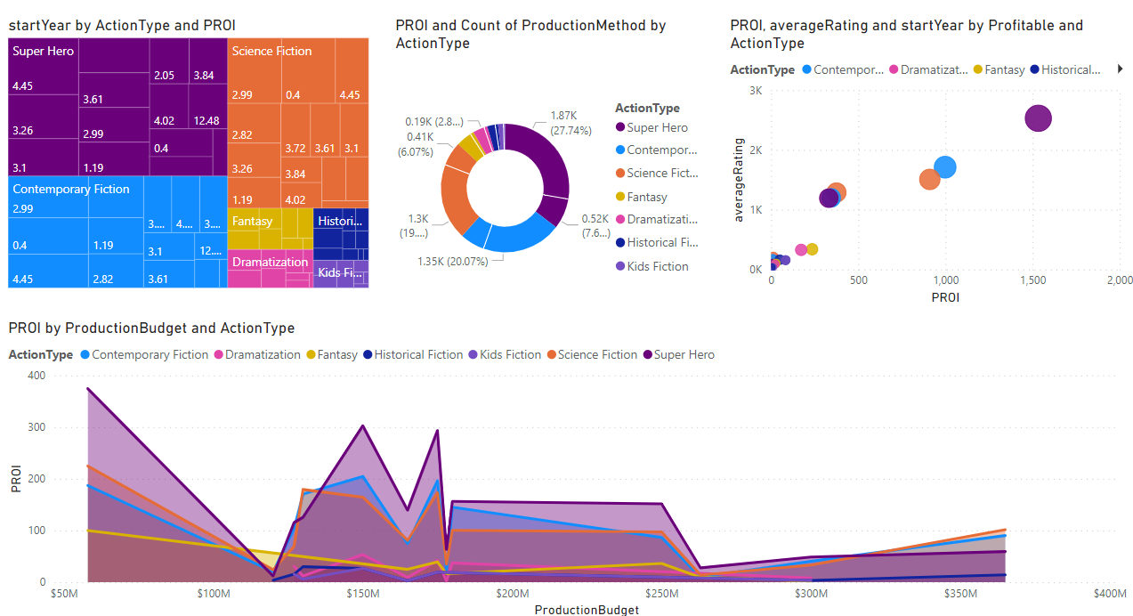
MORE PROI ANALYSIS

Slide 13
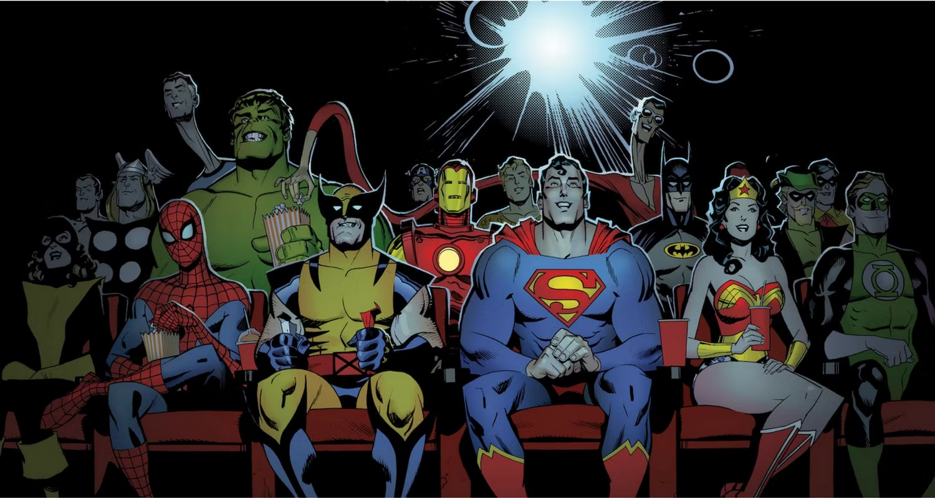
Superhero Movies
Live Action / Animation

Slide 14
Collecting Data
In order to answer this problem statement, I started by collecting a large amount of movie data from IMDB, which contained:
All the movies and their ratings from 1895 till present, all the actors, directors, and staff as well.
I used TheNumbers.com to add more data

Slide 15
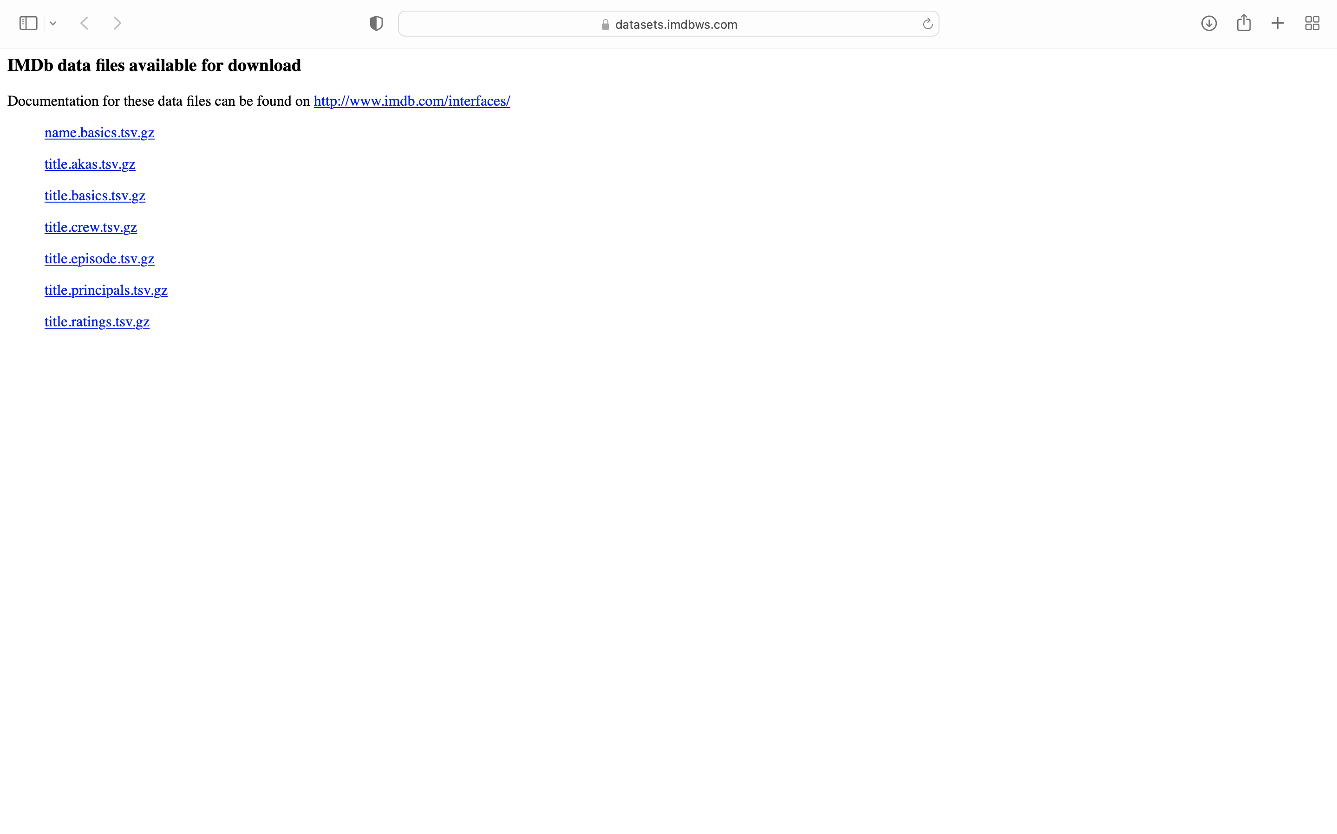
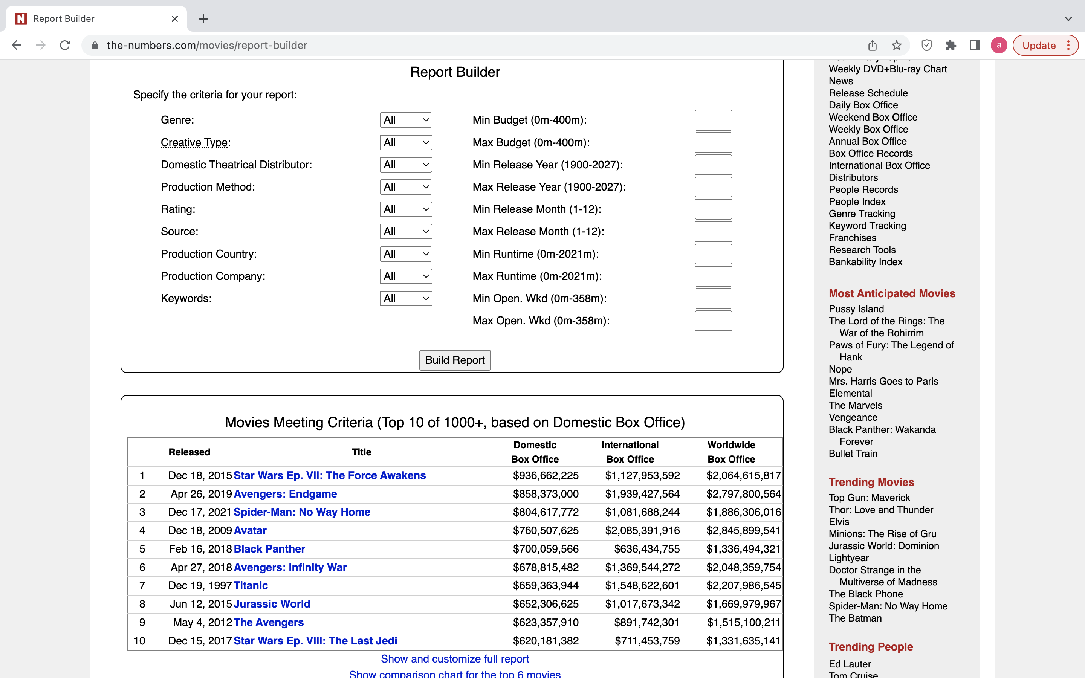
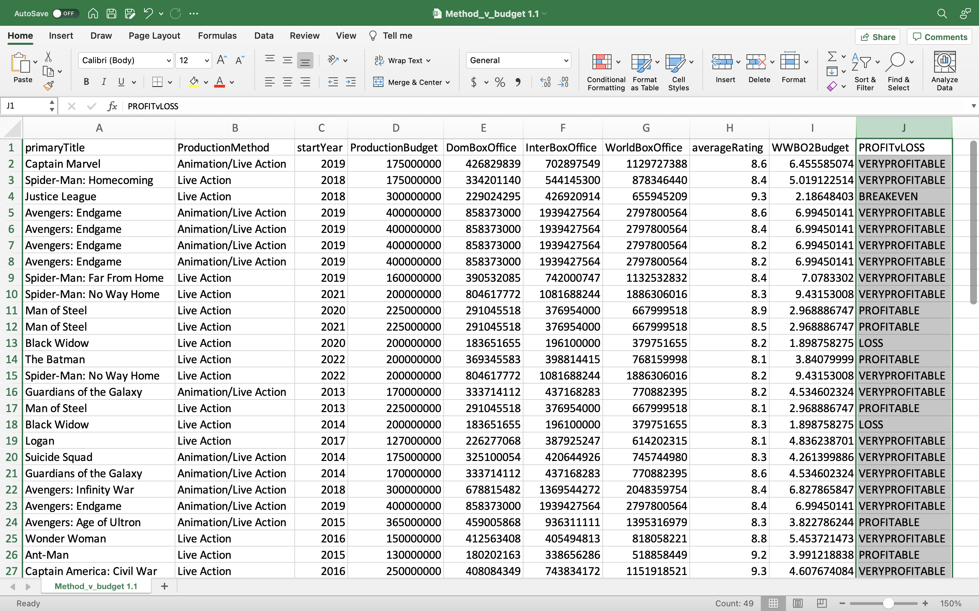
Adding Data from Different Source
I used Excel to screen scrape thenumbers.com data in order to collect the missing data needed to solve the problem statement.
I cleaned up the data, fixed data size, rename titles , removed commas, etc.
I created a new column in the Excel file to show if the movie was profitable or not.
I then saved the file as a CSV so that I can import it into my database.

Slide 16
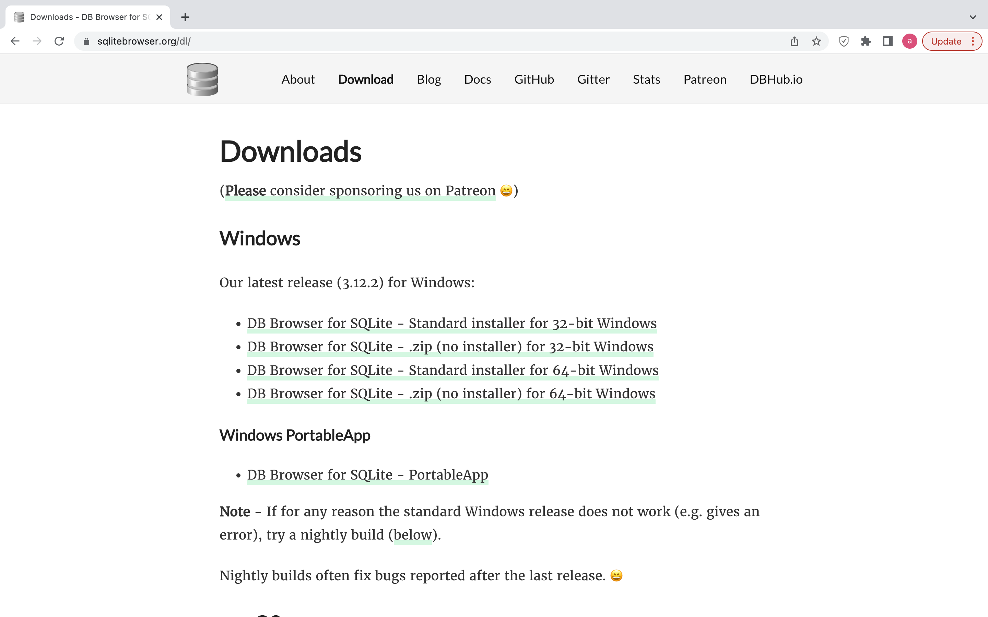
Created a Database
I downloaded DBBrowser to build an SQLite Database.
I had to unzipped and re-saved the IMDB files as TSV files then imported them into the database one by one.
I then imported the IMDB CSV file into the new database.
With the Database complete I can now make SQL Calls

Slide 17
SQL Calls
To make the SQL Calls work, I had to JOIN the tables together.
Once I joined primaryTitle, ProductionMethod, startYear, ProductionBudget, DomBoxOffice, InterBoxOffice, WorldBoxOffice, and averageRating I could start making SQL Calls.
The SQL Calls show information on Superhero Movies with a start year of 2012 and a rating of 8 or higher.
This narrows it down to 21 titles.
I exported to CSV and loaded onto Orange

Slide 18
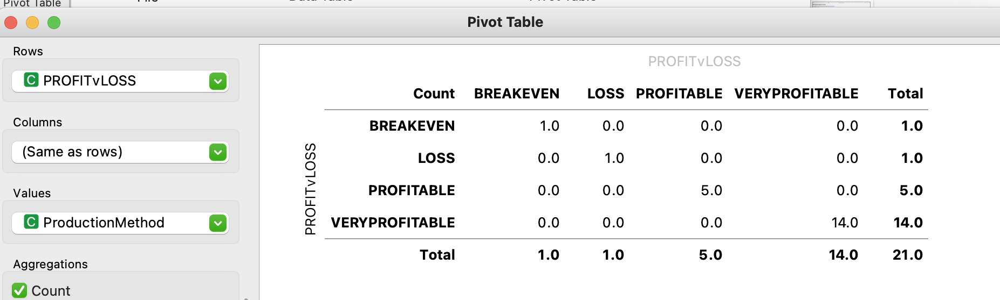
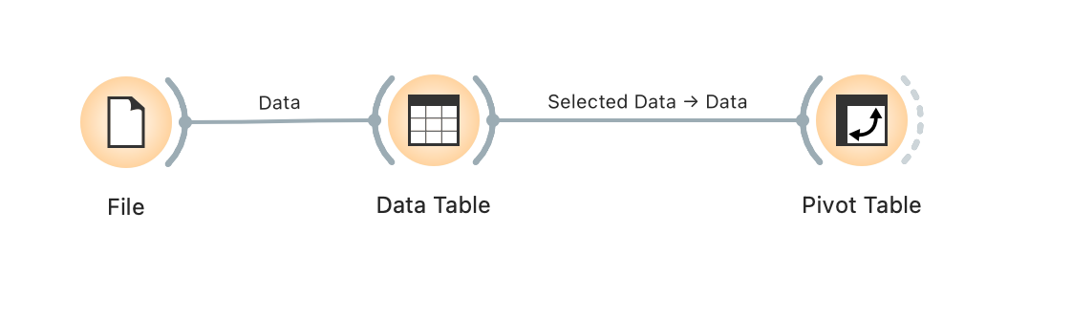
Orange
Once I loaded the Excel file into Orange I could now create a Pivot Table to show how many of the movies fall under the very profitable category.
66.6% or 14 out of 21 are Very Profitable
23.8% or 5 out of 21 are Profitable
1 out of 21 are at a Loss
1 out of 21 are at a Breakeven

Slide 19
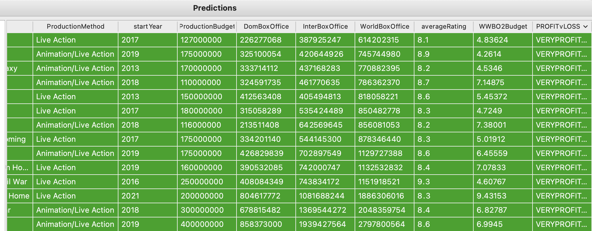
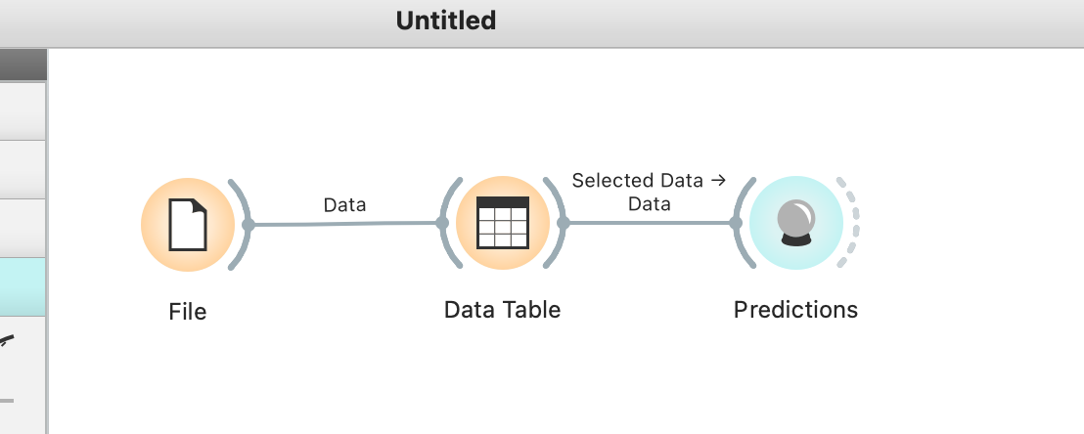
Orange
Now that we know what movies are Very Profitable we can start making prediction.
50% or 7 out of 14 of the Very Profitable movies are Live Action and 50% are Live Action / Animation

Slide 20


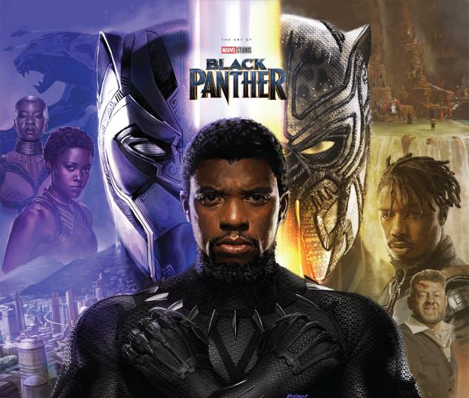
So far we’ve established:
In the Action genre, Superhero movies are among the most profitable in the modern era
Live action versions tend to be more profitable
This leads to my question:
Does the Lead Type and the Cast Diversity have a notable correlation to profitability?

Slide 21
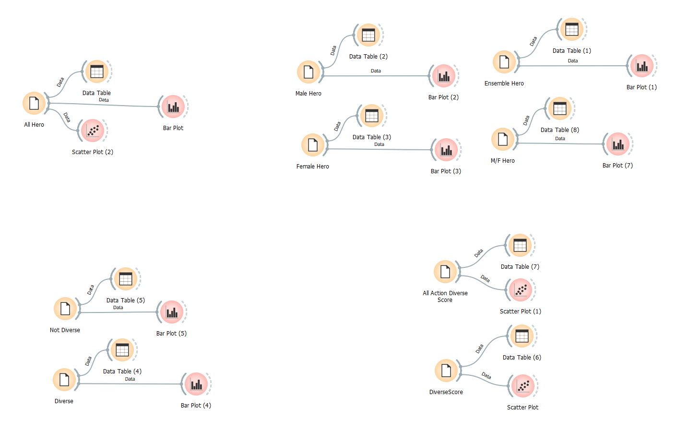
Used Orange, a Python tool, Excel, and DB Browser to Explore and Visualize Data

Slide 22
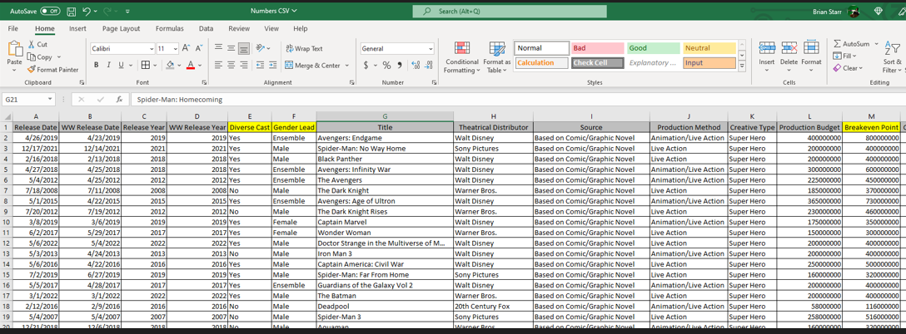
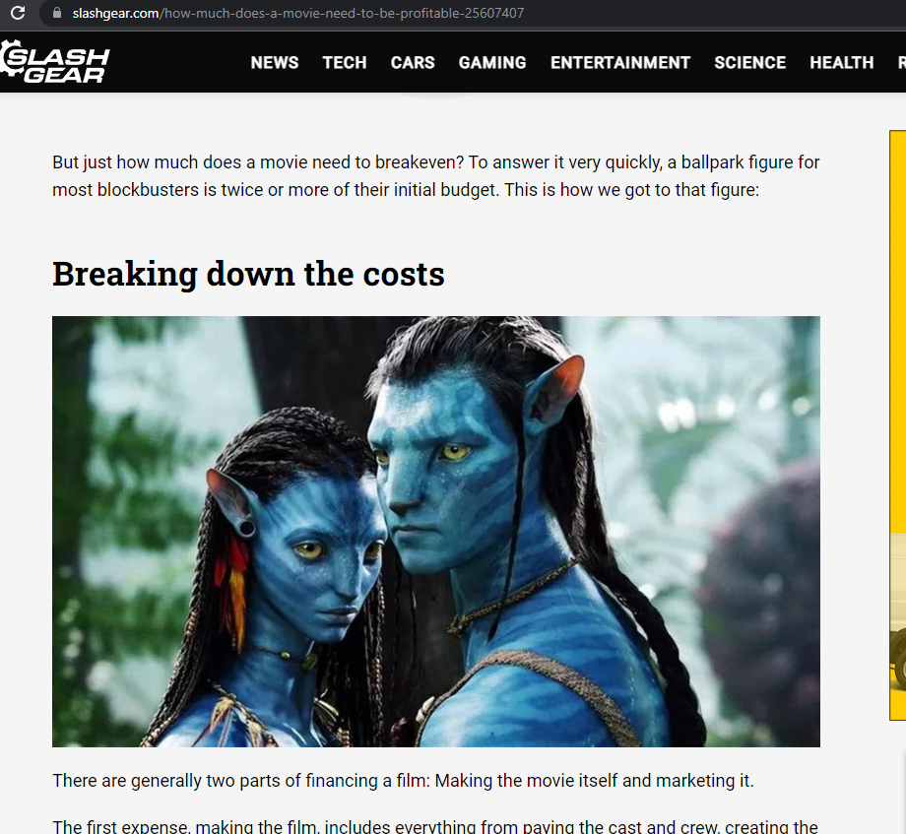
Created some of our own columns to drill down into our data.
Found support for our computed columns.

Slide 23
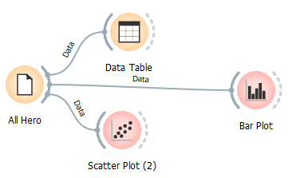
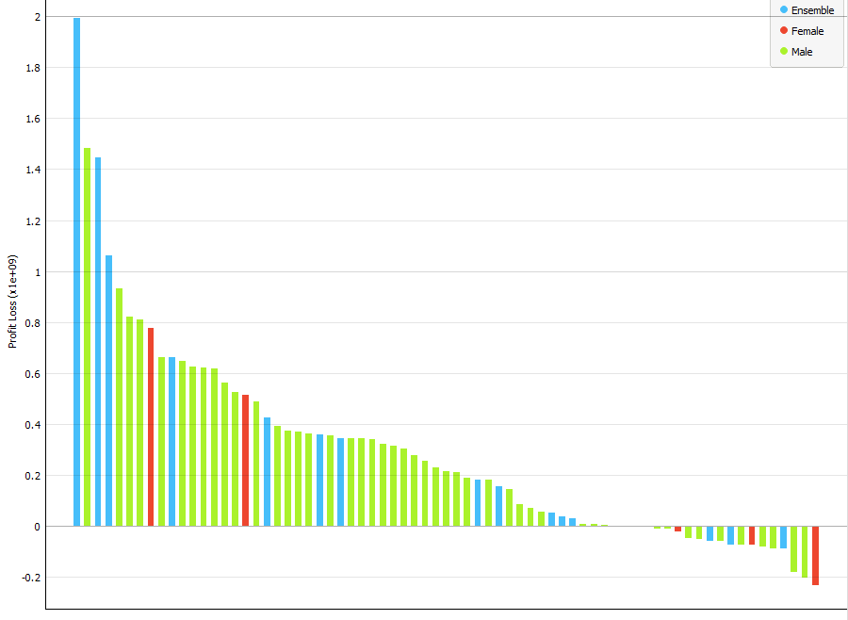
Let’s First look at All our Superhero Movies

Slide 24
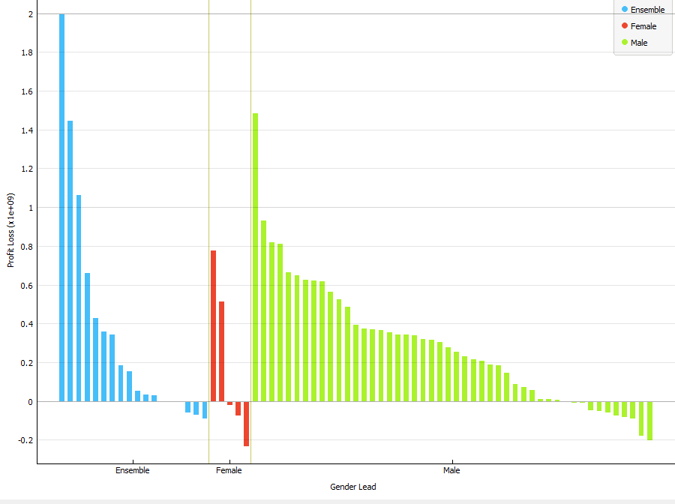
All our Superhero Movies 2

Slide 25
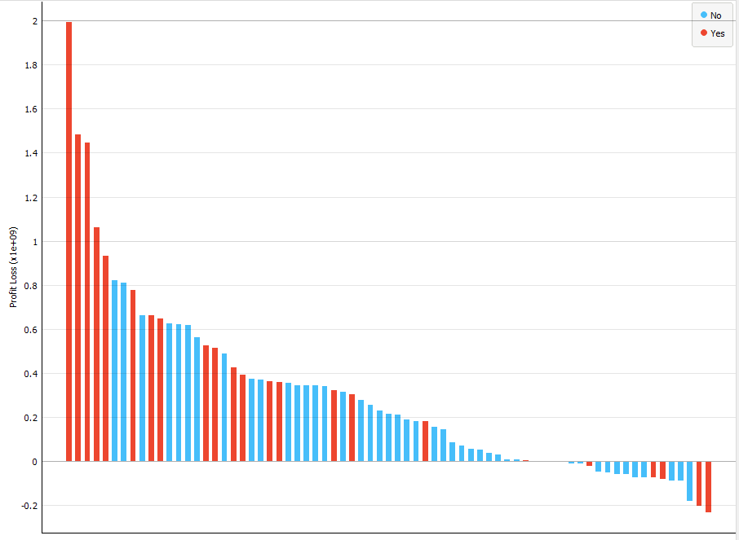
All our Superhero Movies 3

Slide 26
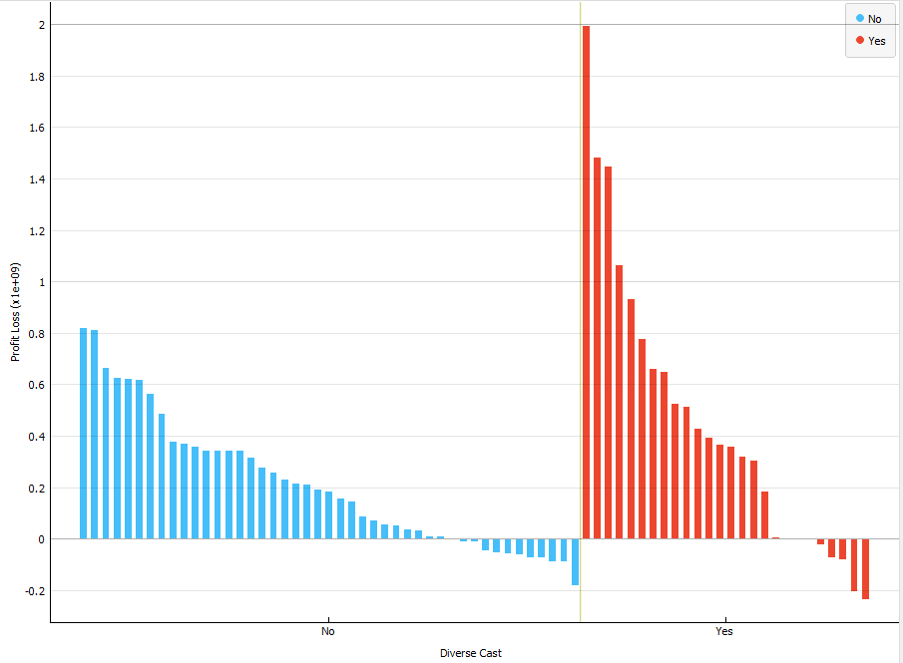
All our Superhero Movies 4

Slide 27
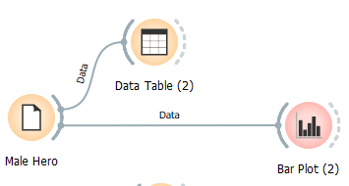
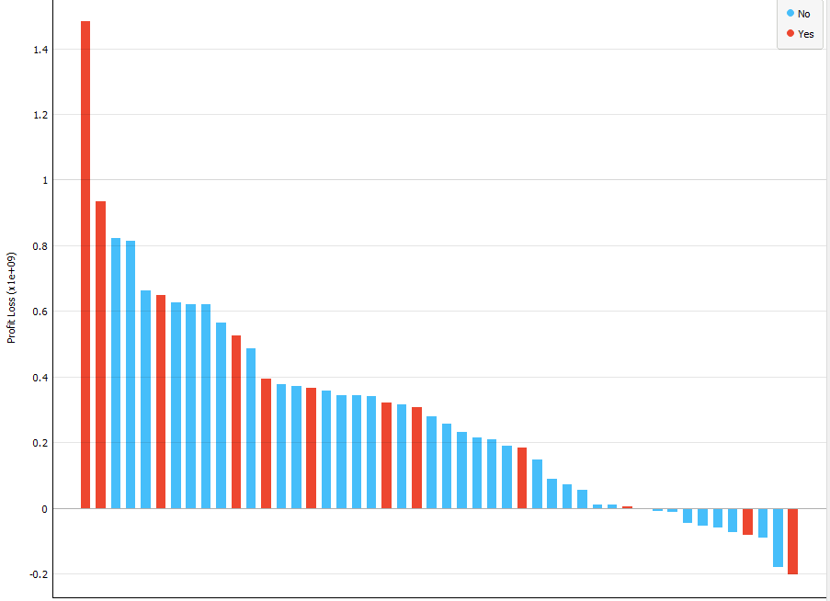
Let’s Next look at All our Male Led Movies

Slide 28
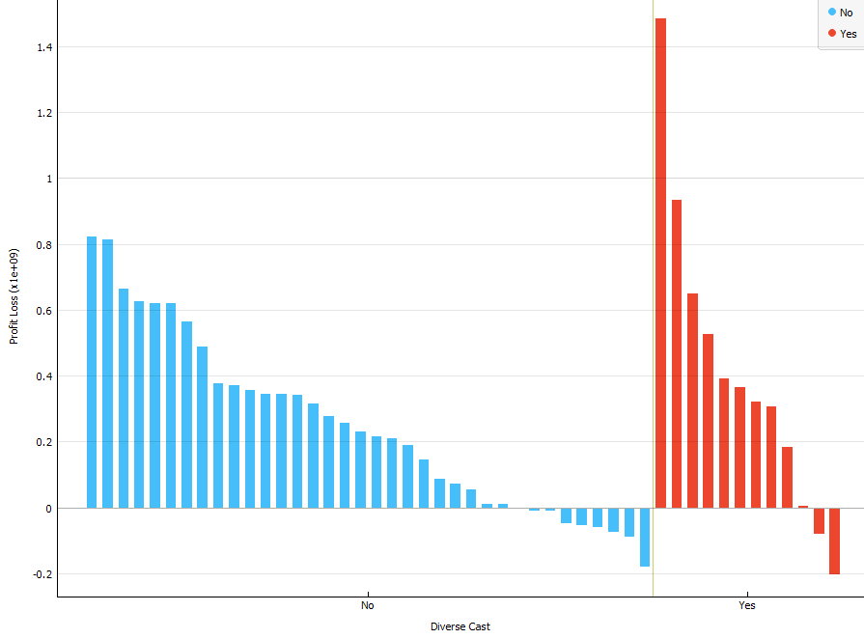
All our Male Led Movies 2

Slide 29
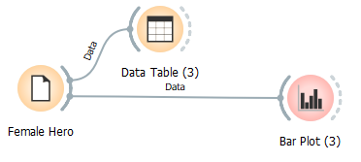
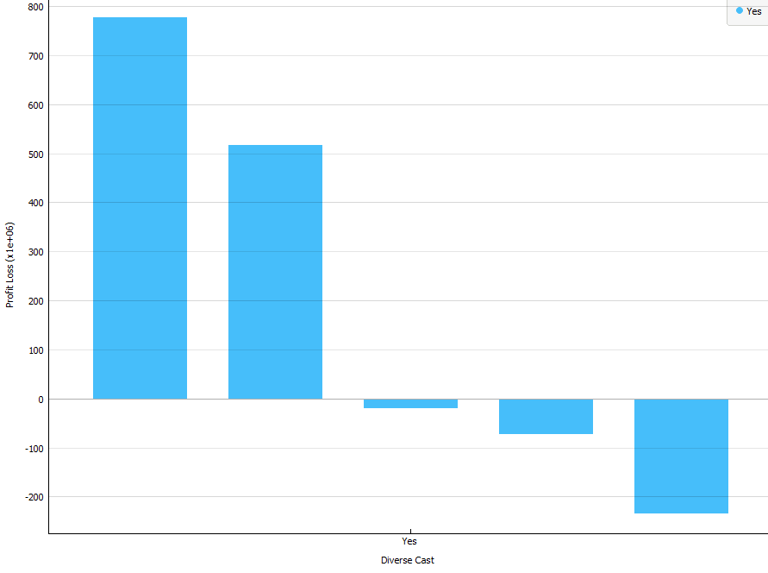
Let’s Next look at All our Female Led Movies
Uh oh! Turns out Female Lead = Diverse

Slide 30
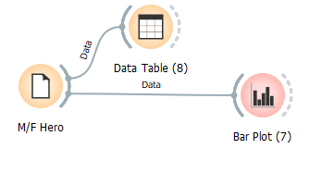
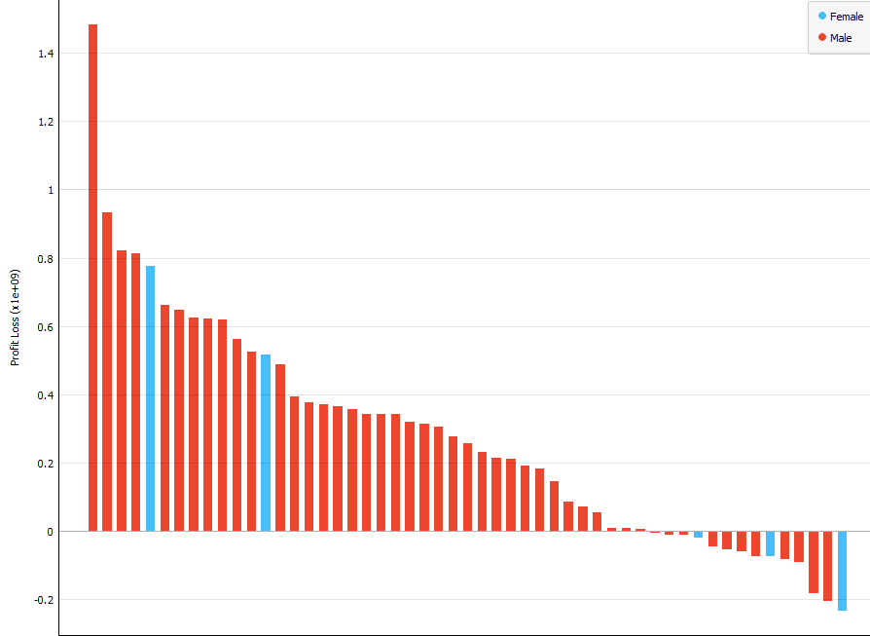
Quick Peek at Male/Female Movies Together

Slide 31
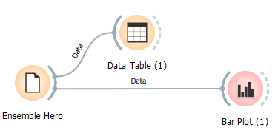
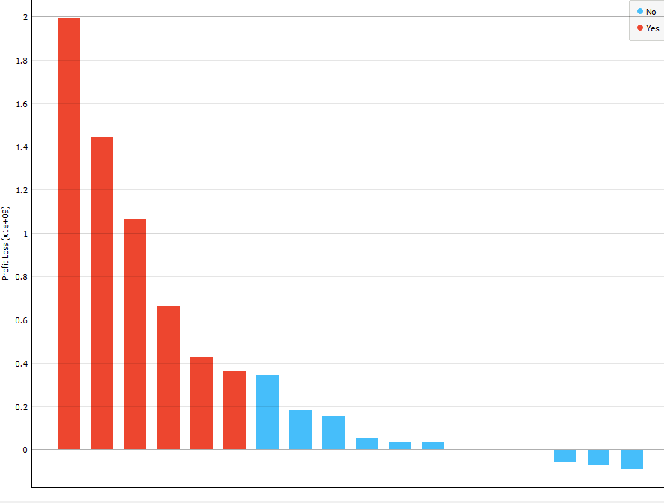
How about our Ensemble Movies?

Slide 32
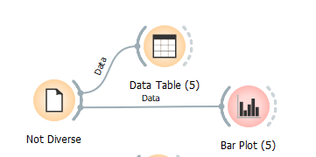
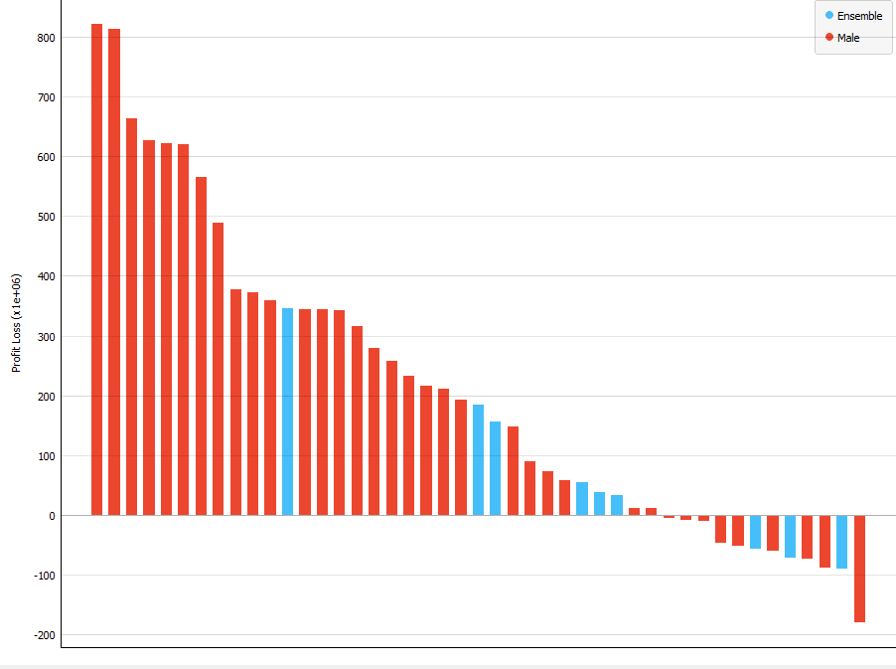
What if we look at just Diversity?
…Or Lack thereof?

Slide 33
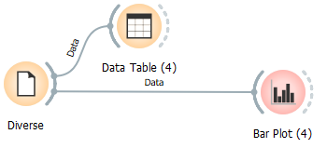
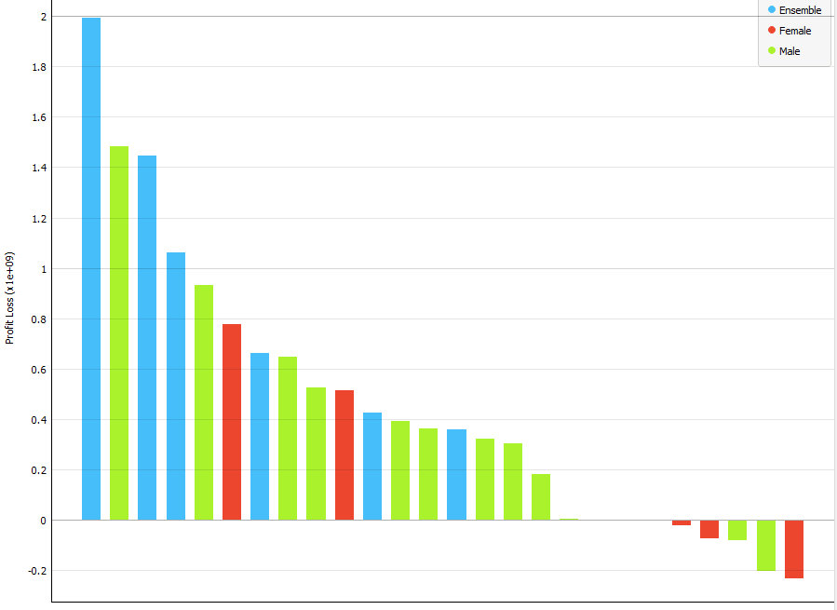
How about WITH Diversity?

Slide 34
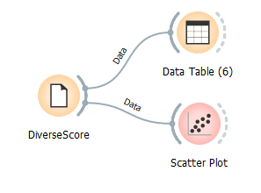

What if we just STOP looking at Bar Graphs!?
Woo…

Slide 35
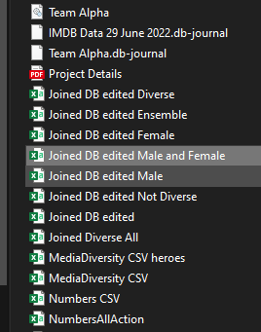

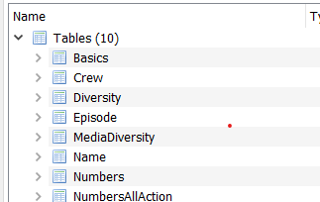
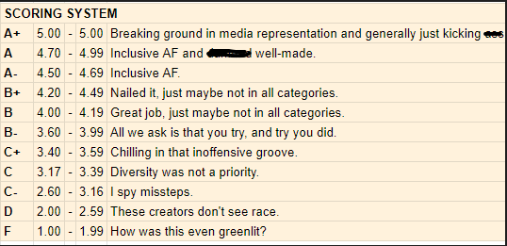


We need some new data...
Back to the Database!
About 200 records of selected films since 2016
This is getting messy!

Slide 36

We were able to get some Diversity Scores
Let’s Scatter!
Hmmm…Not a lot of data left with these more recent Databases joined in.
A few outliers present.
Some positively moving lines regarding Diversity though!

Slide 37

Inflation Adjusted Domestic Box Shows
Some increases in correlation…

Slide 38


Let’s remove the 2 Infinity Wars movies as outliers…
Hey that’s starting to look like some serious correlation!

Slide 39


Okay let’s zoom out and see how our Diversity Theory stacks up for all Action movies (-IW) with a Diversity Score!

Slide 40





And there’s the rub… Diversity could be a ticket to a bigger payday, at least in Action and Superhero movies!
Other studies seem to agree.

Slide 41





Finally, let’s take our model and try to predict the outcome of a future film using a Decision Tree!

Slide 42
To Review:
- Utilizing various databases such as IMDB, Numbers, Mediaversity, etc
- And skills with DB Browser, SQL, Orange, Excel, and Google-fu along with analytics knowledge garnered along the way in bootcamp…
- We Downloaded, Scraped, Queried, Explored, Cleaned, Computed, Filled in Some Blanks, Explored again…and again.
- And found some (hopefully) satisfactory ways to impress upon you that Superhero movies continue to be a big money maker in Hollywood, especially Live Action films! And Diversity could be a key contributor to increased profitability in Superhero movies, and other media alike.
Although we do confess there is plenty of work left to do on the subject, we learned a lot about plugging ahead, learning on the fly, and how to be better organized next time!
Questions?

